Slide 1
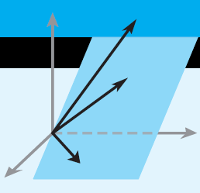
Elementary Linear Algebra
Howard Anton
Copyright © 2010 by John Wiley & Sons, Inc.
All rights reserved.
Chapter 6

Slide 2
Chapter 6
Inner Product Spaces
6.1 Inner Products
6.2 Angle and Orthogonality in Inner
Product Spaces
6.3 Gram-Schmidt Process;
QR-Decomposition
6.4 Best Approximation; Least Squares
6.5 Least Squares Fitting to Data
6.6 Function Approximation; Fourier Series

Slide 3
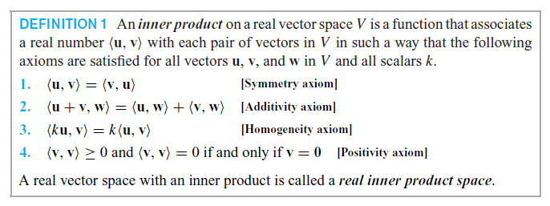

Section 6.1 Inner Products

Slide 4
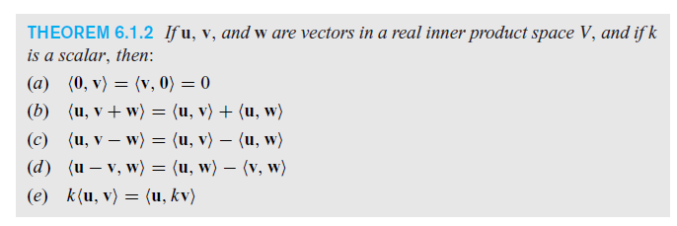
Algebraic Properties of Inner Products

Slide 5
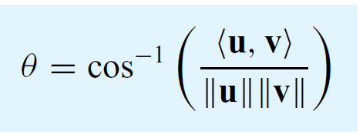
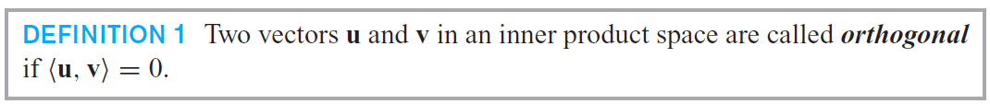
θ: the angle between u and v

Slide 6
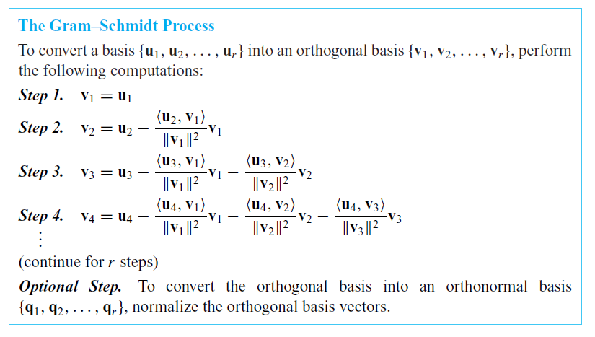
Section 6.3 Gram-Schmidt Process; QR-Decomposition

Slide 7
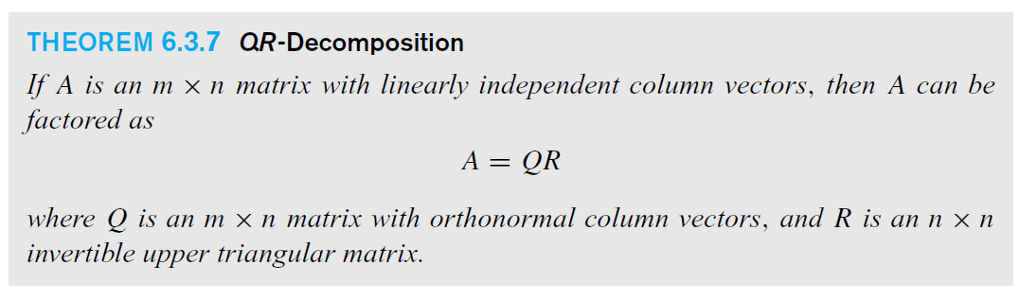
QR-Decomposition

Slide 8
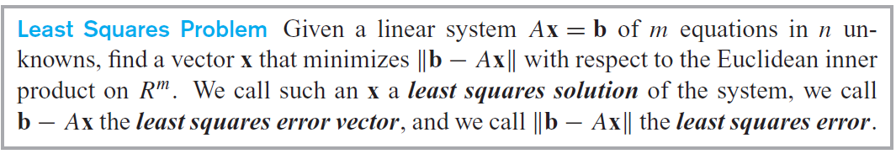
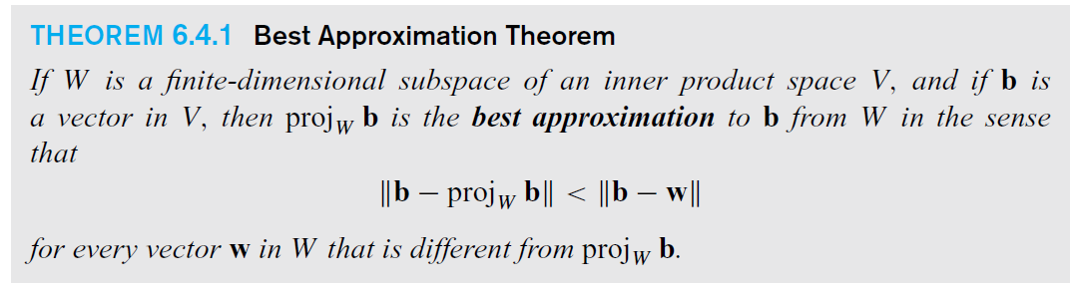
Section 6.4 Best Approximation;
Least Squares

Slide 9
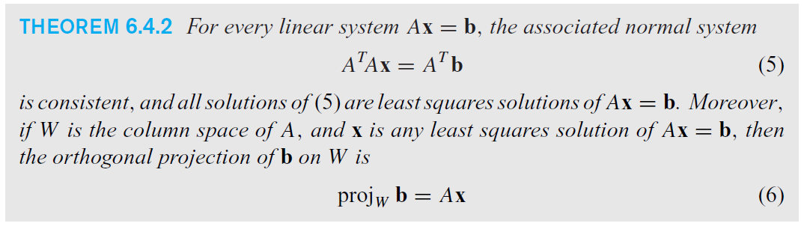
Least squares solutions to Ax = b

Slide 10
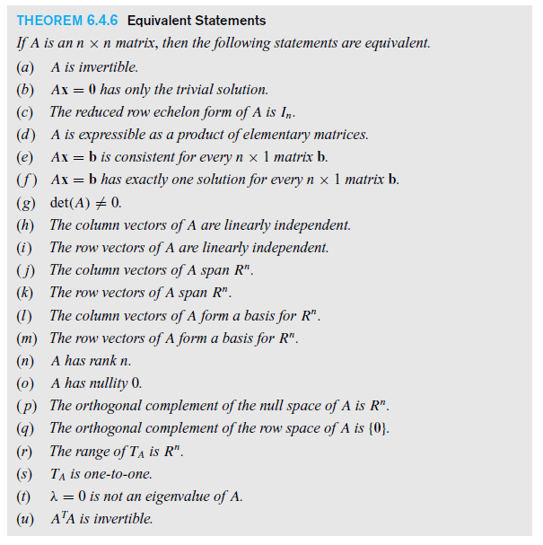

Slide 11
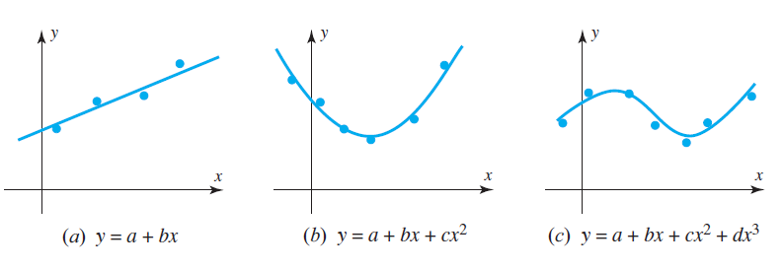
Section 6.5 Least Squares
Fitting to Data

Slide 12
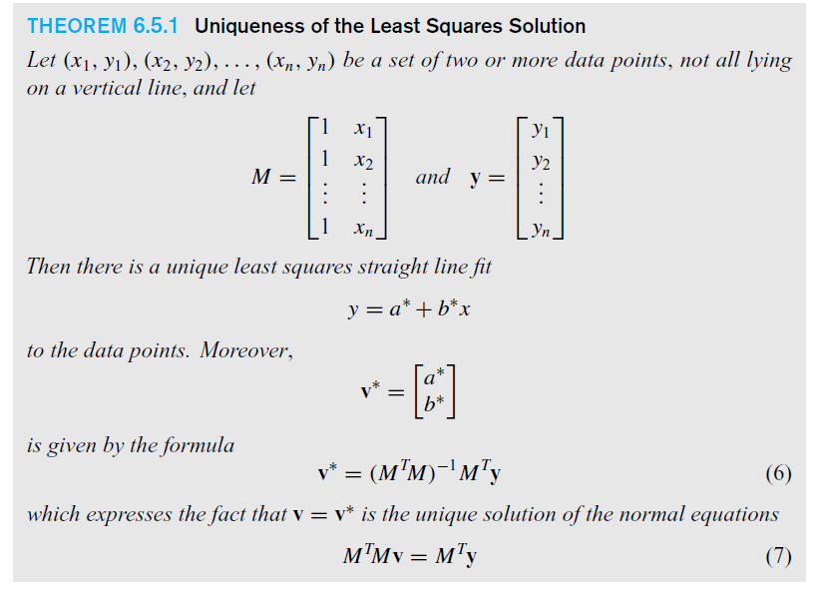
The Least Squares Solution

Slide 13
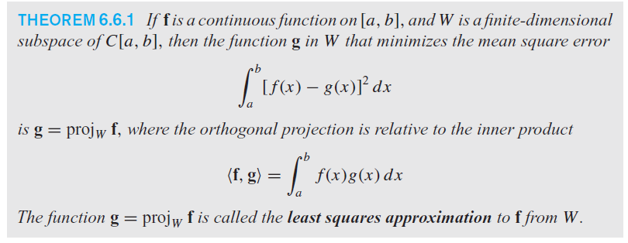
Section 6.6 Function Approximation; Fourier Series

Slide 14
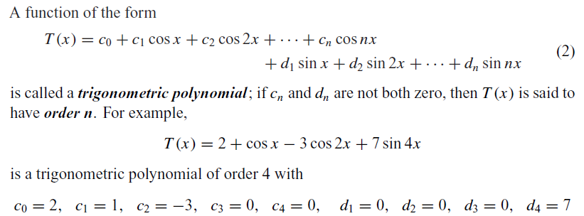

Fourier Coefficients & Series

Slide 15
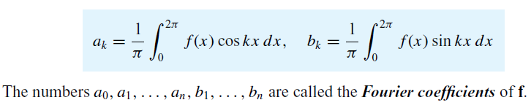


Slide 16
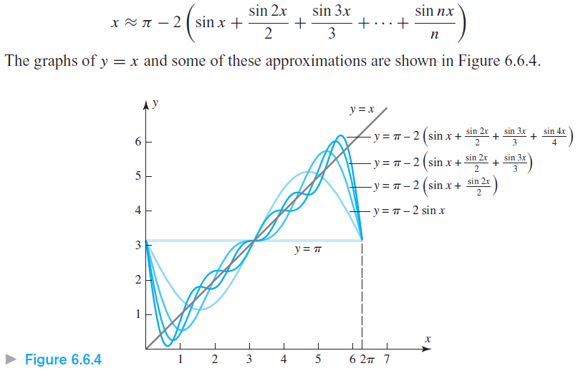
Fourier Approximation to y = x

